Slide 1
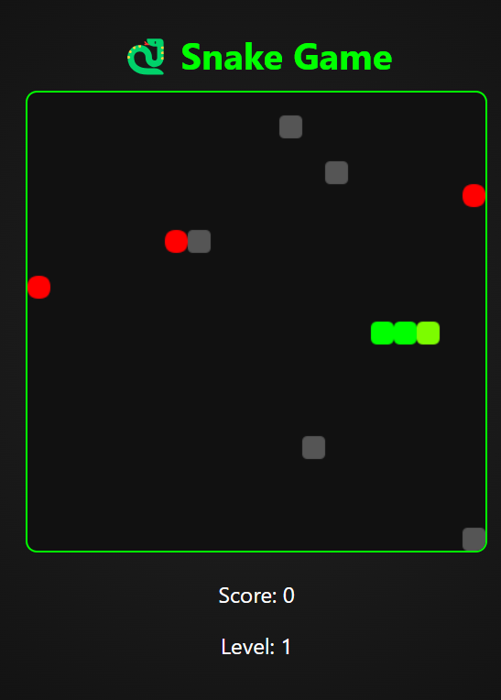
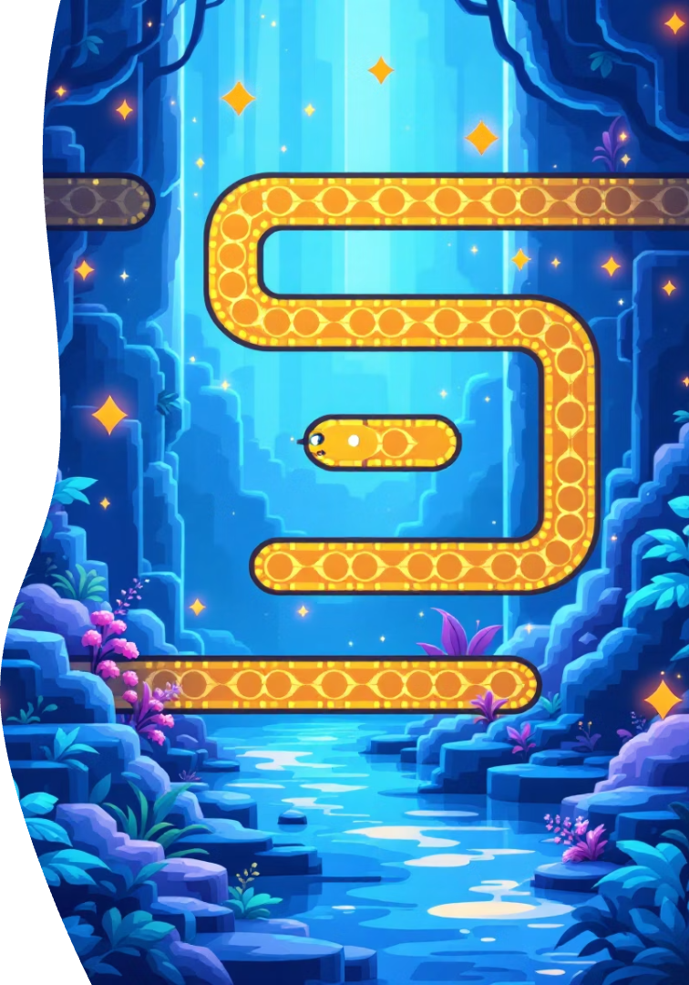
Snake Game: From Zero to Hero with HTML, CSS, & JavaScript
The classic Snake game meets modern web tech. Build it live with HTML, CSS, and JavaScript for interactive fun and learning.
BY-
Baibhab Mund
Siddhant Vikram Singh

Slide 2
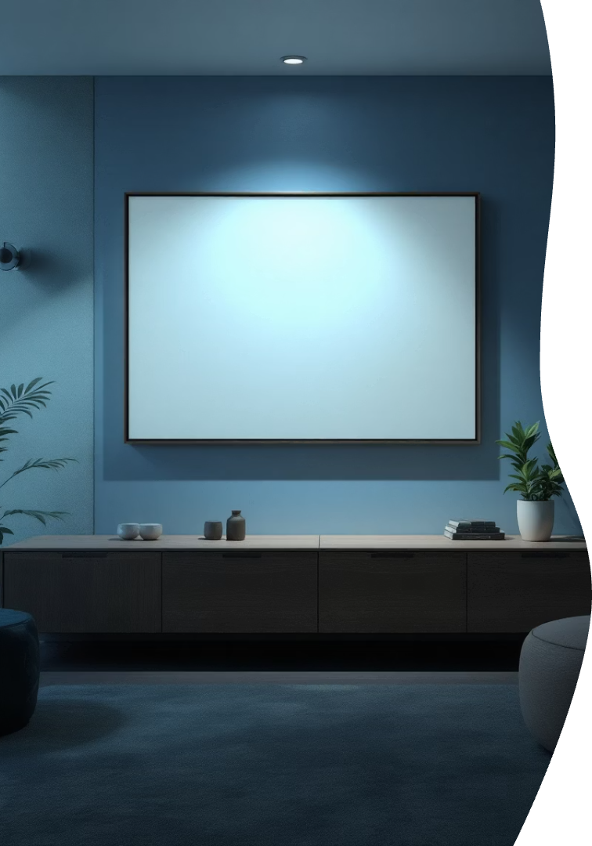

Styling the Snake: CSS Aesthetics
Center Canvas
Color Coding
Use CSS flexbox or margin auto to center the game board visually.
Set snake color to green and food color to red for clarity and appeal.
Background & Borders
Add a subtle background color and a 1px black border on the canvas.

Slide 3
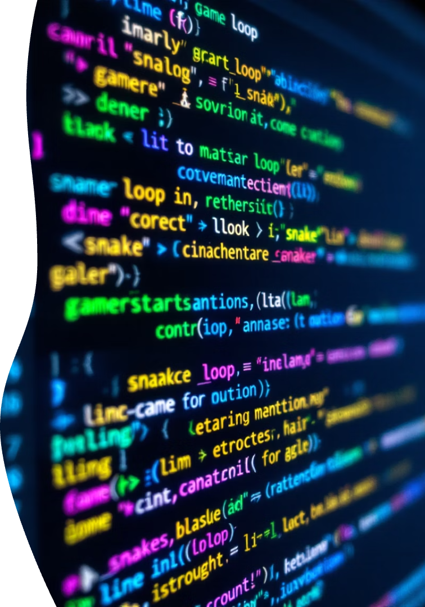
Core Logic: JavaScript Fundamentals
Game Loop
Use `setInterval()` to update game state continuously at fixed intervals.
Snake Movement
Update x and y coordinates by dx and dy to move the snake smoothly.
Food Generation
Randomize food position within canvas boundaries for variety.
Collision Detection
Check collisions with walls or snake body to end the game.

Slide 4
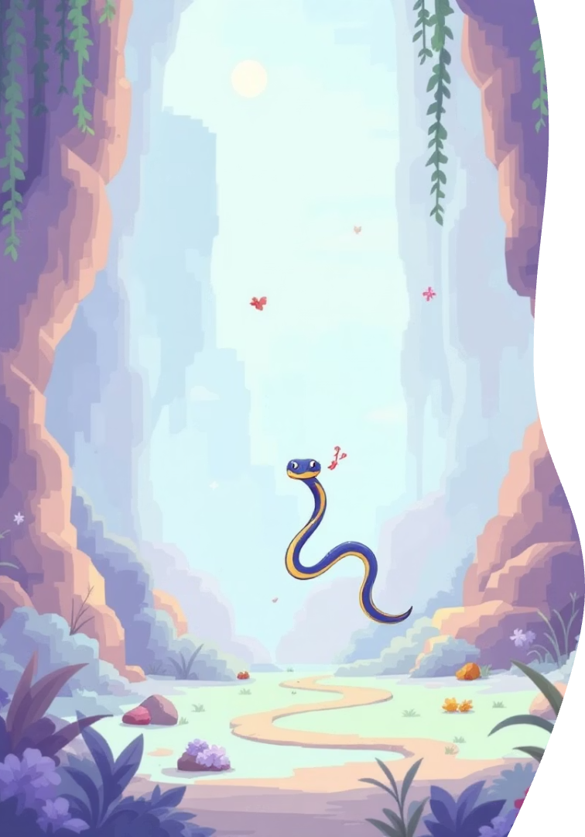
Snake Mechanics: Implementing the Game
Snake Array
Store all segments as objects with x and y positions.
Drawing Snake
Loop through the array to draw each segment on the canvas.
Eating Food
Increase snake length and reposition food after eating.
Scoring
Increment score every time the snake consumes food.

Slide 5




User Interaction: Keyboard Controls
Event Listeners
Detect key presses with `document.addEventListener('keydown', ...)`.
Change Direction
Update dx and dy based on arrow keys or WASD input.
Opposite Movement Block
Prevent reversing direction instantly to avoid game breaking.

Slide 6




Advanced Features: Level Up Your Game
Increase Speed
Add Obstacles
1
Gradually speed up the game to increase challenge.
Place blocks that snake must avoid for extra difficulty.
2
Sound Effects
4
Power-Ups
Include audio feedback for eating, moving, and game over events.
3
Implement temporary powers like invincibility or score boosts.

Slide 7
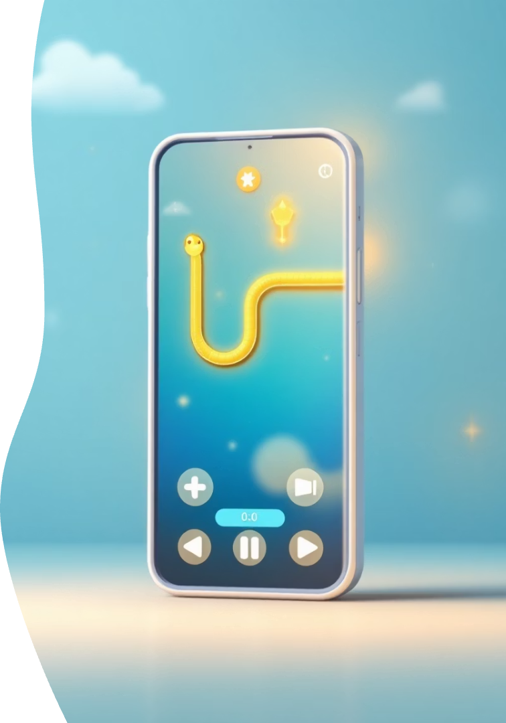




Enhancements & Future Development
Mobile Friendly
Touch Controls
High Scores
Save top scores locally to encourage competition.
Use CSS media queries for varying screen sizes.
Add swipe and tap interactions for mobile users.
New Modes
Introduce timed challenges, mazes, and other gameplay variants.

Slide 8
THANK YOU

